Slide 1
Enhanced Thyroid Disease Prediction Through Machine Learning and Deep Learning: A Comparative Approach
Registration No: Author’s Name:
18502003701 Rehnuma Tarannum
18502003735 Sharmin Akter Reka

Slide 2
Contents
Overview
Introduction
Motivation
Research Goal
Literature Review
Methodology
Dataset Description
Model Description
Result of ML Algorithms
Plotting of ML Algorithms Results
Confusion Matrix
Confusion Matrix Accuracy
Mean Squared Error (MSE)
Root Mean Squared Error (RMSE)
Comparison of ML and DL
Conclusion
References

Slide 3
Overview
This research focuses on the comparative analysis of machine learning (ML) and deep learning (DL) techniques in the context of predicting thyroid disease.
Explores several machine learning algorithms, including logistic regression, decision trees, support vector machines (SVM), and random forests. Each of these techniques offers unique advantages in terms of interpretability and accuracy.
The study deep learning approaches, particularly recurrent neural networks (RNN), which are known for their capability to handle complex data and improve predictive performance.
By evaluating and comparing the effectiveness of these methodologies, the study aims to enhance diagnostic accuracy for thyroid disease, ultimately contributing to better patient outcomes in healthcare.

Slide 4
Introduction
Thyroid diseases impact millions globally, crucial for metabolism and overall health.
World Health Organization (WHO) estimating that 750 million people worldwide suffer from some form of thyroid disorder.[10]
In Bangladesh, the situation is particularly concerning. With an estimated 50 million people affected by thyroid disorders, nearly 30 million remain undiagnosed, causing avoidable complications due to the lack of early diagnosis.[11]
According to the sources, around 10% of Bangladeshi people suffer from clinically evident thyroid disorders.
The disease disproportionately affects women, with 20-30% of women in Bangladesh at risk of developing thyroid-related issues.

Slide 5
Motivation
Traditional diagnostic approaches often lack the precision necessary for accurate detection.
This research is motivated by the urgent need to address the diagnostic challenges associated with thyroid disease, both globally and within Bangladesh.
The comparative analysis contributes to medical informatics and ensures better outcomes for those affected by thyroid disorders.

Slide 6
Research Goal
To address the diagnostic challenges of thyroid disease both globally and in Bangladesh.
To utilize machine learning (ML) and deep learning (DL) models for developing an effective predictive system.
To improve early detection rates and reduce the number of undiagnosed thyroid disease cases.
To explore the application of AI technologies in healthcare for better disease management.

Slide 7
Literature Review
Year | Authors | Key Findings | Research Gap
2016 | Obermeyer et al.[1] | Machine learning (ML) and artificial intelligence (AI) are vital in medical data processing, showing potential for future healthcare integration. | General focus on AI in healthcare, but specific thyroid-related AI research is limited.
2015 | Ghahramani et al.[2] | Introduced unsupervised learning for discovering hidden patterns in complex, unlabeled medical datasets. | Limited application of unsupervised learning for thyroid disease detection.
2020 | Chaubey et al.[3] | Compared logistic regression, decision trees, and k-nearest neighbor (k-NN) for thyroid disease prediction, with k-NN achieving 96.875% accuracy using the UCI dataset. | No exploration of deep learning techniques. Focused on basic ML models.

Slide 8
Literature Review
Year | Authors | Key Findings | Research Gap
2019 | Raghuraman et al.[6] | Applied SVM, Multiple Linear Regression, and Decision Trees for thyroid disease diagnosis, with Decision Tree achieving the highest accuracy of 97.97%. | Focused on traditional ML methods with limited exploration of DL.
2020 | Dharmarajan et al.[7] | Applied decision trees and SVM for thyroid disease classification, achieving 97.35% accuracy with decision trees. | Limited focus on deep learning techniques.
2020 | Dhyan Chandra Yadav et al. [8] | Proposed a decision tree ensemble with 99.95% accuracy using dimensionality reduction and data augmentation techniques. | Despite high accuracy, deep learning models were not evaluated.

Slide 9
Literature Review
Year | Authors | Key Findings | Research Gap
2016 | Geetha and Baboo et al.[9] | Used dimensionality reduction with Hybrid Differential Evolution Kernel Based Naïve Bayes for thyroid disease classification, achieving 97.97% accuracy. | Did not explore deep learning techniques or advanced hybrid models.
2018 | Menger et al.[4] | Demonstrated the superior performance of deep learning (DL) in time-variable data predictions. Applied it to violence prediction in clinical settings, not thyroid disease. | Limited application of DL to thyroid disease prediction. DL’s potential is underexplored in this domain.
2016 | Prasad et al.[5] | Developed a hybrid architecture system using rough data sets and ML algorithms to predict thyroid diseases. | Hybrid models are promising, but no integration with DL methods was explored.

Slide 10
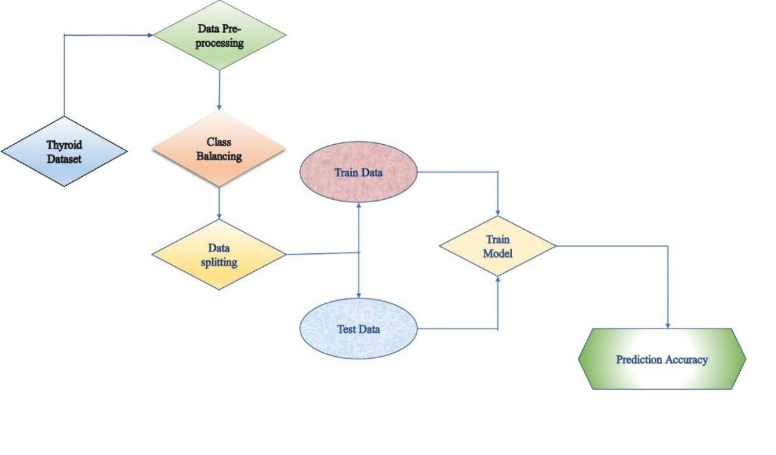
Methodology
Figure: Architecture of Thyroid disease prediction

Slide 11
Dataset Description
Thyroid Dataset selection and preparation
Sourced from Kaggle.[13]
Includes 3,772 observations and 30 attributes.
Target class: Binary classification (sick or healthy).
Attributes: Include hormone levels (T3, T4), age, gender, etc.
Importance of dataset: Key to the accuracy and robustness of the models.

Slide 12
Dataset Description (Cont.)
Data Preprocessing
Purpose: To clean and prepare the dataset for accurate model training.
Steps Involved:
Handling Missing Data: Missing values are imputed or removed to avoid bias.
Feature Selection: Only the most relevant features, like hormone levels (T3, T4, TSH), are retained for analysis.
Data Normalization: Scaling features to standardize ranges for better model convergence.

Slide 13
Dataset Description (Cont.)
Class Balancing
Problem: The dataset has an imbalance between the two target classes (healthy vs. thyroid-disease-affected).
SMOTE (Synthetic Minority Over-sampling Technique) was applied to generate synthetic examples for the minority class.
Impact: Helps avoid model bias toward the majority class, improving accuracy for detecting thyroid disease.

Slide 14
Dataset Description (Cont.)
Data Splitting
Purpose: To evaluate model performance on unseen data.
The features (X) were separated from the target variable (y), which predicts the thyroid disease class (sick or healthy).
train_size: 70% of the data was allocated for training and 30% for testing.
random_state: Set to 42 to ensure reproducibility across different runs.

Slide 15
Model Description
Train Model
Key Factors
Quality of Training Data: High-quality, well-prepared data is essential for effective training.
Algorithm Selection: Choosing the right algorithm is critical for achieving optimal performance.
We trained the following models to evaluate their performance: Logistic Regression, Decision Tree, Support Vector Machine (Linear Kernel), Support Vector Machine (RBF Kernel), Random Forest, Recurrent Neural Network (RNN)
Training and Testing Accuracy: Each model was trained and evaluated to determine its accuracy on both training and testing datasets.

Slide 16
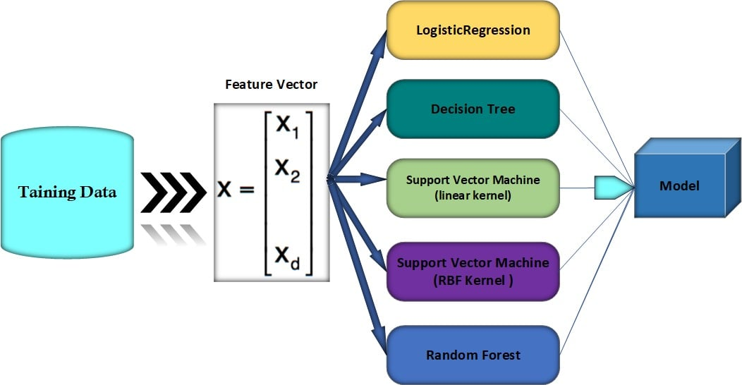
Model Description
Figure: Model Description

Slide 17
Model Description (Cont.)
Confusion Matrix
Purpose: To evaluate model performance by comparing actual vs. predicted outcomes. Components:
True Positives (TP) (11): Correctly predicted thyroid cases.
True Negatives (TN) (00): Correctly predicted healthy cases.
False Positives (FP) (01): Incorrectly predicted thyroid cases (Type I error).
False Negatives (FN) (10): Incorrectly predicted healthy cases (Type II error).
Confusion matrix helps to explores precision, recall, F-1 score, and accuracy.

Slide 18
Result of ML Algorithms
Algorithm | Logistic Regression | Decision Tree | SVM (Linear Kernel) | SVM(RBF Kernel) | Random Forest
Test Accuracy (%) | 96.69% | 98.44% | 96.78% | 97.15% | 98.25%
Training Accuracy (%) | 91.19% | 99.73% | 91.61% | 99.33% | 100%
Precision (%) | 77.97% | 88.24% | 80.36% | 82.76% | 87.88%
Recall (%) | 66.67% | 86.96% | 65.22% | 69% | 84.06%
F1-Score (%) | 71.88% | 87.59% | 72% | 75.59% | 85.93%

Slide 19
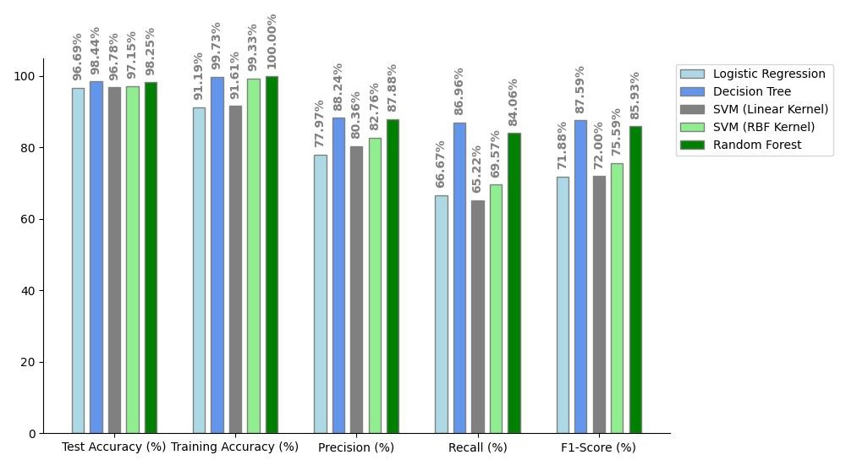
Plotting of ML Algorithms Results
The overall performance in system, the decision tree algorithm represents the ideal model for dataset.

Slide 20
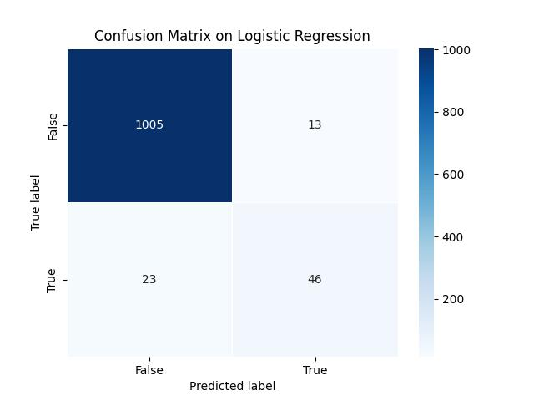
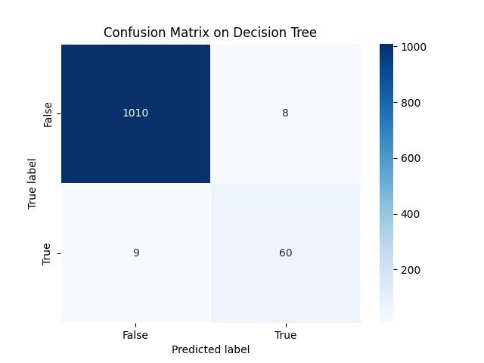
Confusion Matrix

Slide 21
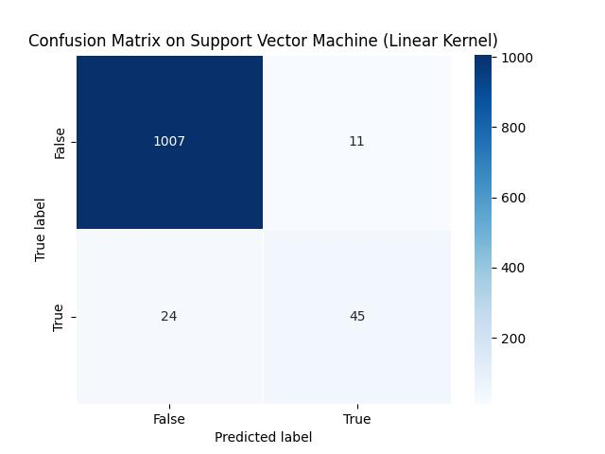
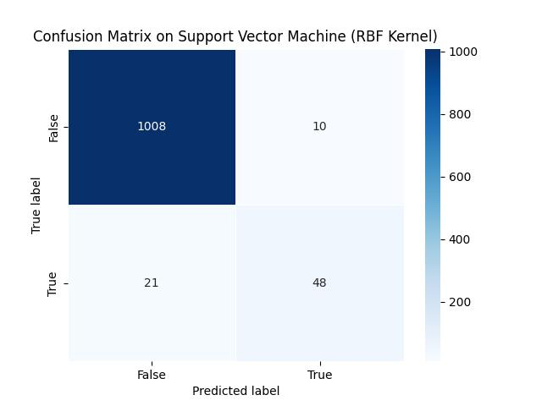
Confusion Matrix

Slide 22

Confusion Matrix

Slide 23
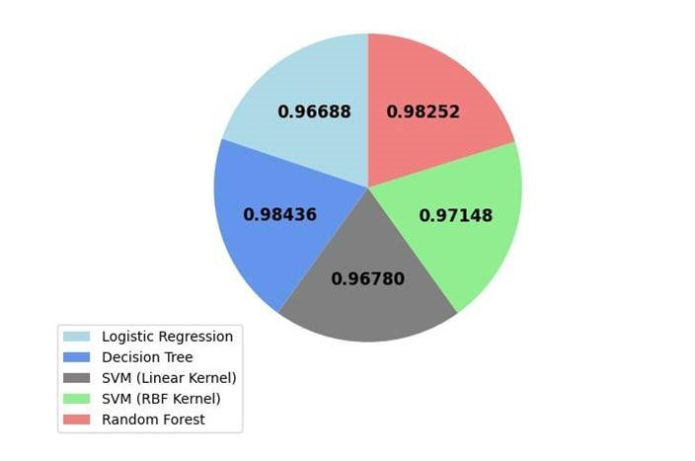
Confusion Matrix Accuracy
Algorithm | Confusion Matrix Accuracy
Logistic Regression | 0.96688
Decision Tree | 0.98436
Support Vector Machine (Linear Kernel) | 0.96780
Support Vector Machine (RBF Kernel) | 0.97148
Random Forest | 0.98252

Slide 24
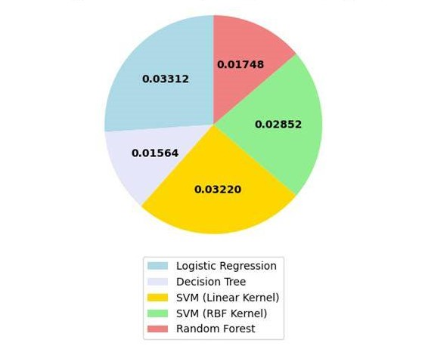
Mean Squared Error (MSE)
Algorithm | Mean Squared Error (MSE)
Logistic Regression | 0.03312
Decision Tree | 0.01564
Support Vector Machine (Linear Kernel) | 0.03220
Support Vector Machine (RBF Kernel) | 0.02852
Random Forest | 0.01748

Slide 25
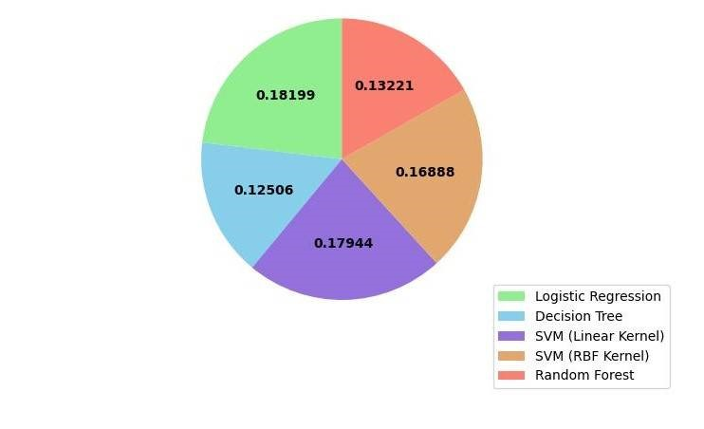
Root Mean Squared Error (RMSE)
Algorithm | Root Mean Squared Error (RMSE)
Logistic Regression | 0.18199
Decision Tree | 0.12506
Support Vector Machine (Linear Kernel) | 0.17944
Support Vector Machine (RBF Kernel) | 0.16888
Random Forest | 0.13221

Slide 26
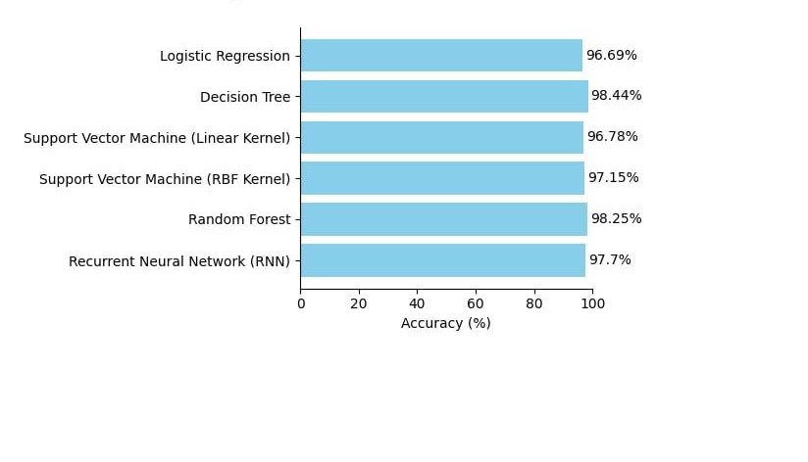
Comparison of ML and DL
Algorithm | Accuracy
Logistic Regression | 96.69%
Decision Tree | 98.44%
Support Vector Machine (Linear Kernel) | 96.78%
Support Vector Machine (RBF Kernel) | 97.15%
Random Forest | 98.25%
Recurrent neural network (RNN) | 97.7%

Slide 27
Conclusion
Decision Tree algorithm achieved the highest accuracy in machine learning models with 98.44%.
Recurrent Neural Networks (RNNs) demonstrated strong performance in deep learning with 97.7% accuracy.
The integration of AI can reduce undiagnosed thyroid cases, improving patient outcomes.

Slide 28
References
[1] Obermeyer Z, Emanuel EJ. Predicting the future— big data, machine learning, and clinical medicine. N Engl J Med. 2016; 375:12161219.
[2] Ghahramani Z. Probabilistic machine learning and artificial intelligence. Nature. 2015;521: 452-459.
[3] G. Chaubey, D. Bisen, S. Arjaria, and V. Yadav, “Thyroid Disease Prediction Using Machine Learning Approaches”, Natl. Acad. Sci. Lett., (2020).
[4] Menger, V., Scheepers, F., & Spruit, M. (2018). Comparing deep learning and classical machine learning approaches, for predicting inpatient violence incidents from clinical text. Applied Sciences, 8, 981.
[5] Prasad, V., Srinivasa Rao, T., & Surendra Prasad Babu, M. (2016). Thyroid disease diagnosis via hybrid architecture composing rough data sets theory and machine learning algorithms. Soft Computing, 20(3), 1179–1189.
[6] Raghuraman, M. T., Sailatha, E., Gunasekaran, S. (2019). Efficient thyroid disease prediction and comparative study using machine learning algorithms. International Journal of Information and Computing Science. 6(6), 617–624.

Slide 29
References
[7] Dharmarajan, K., Balasree, K., Arunachalam, A. S., & Abirmai, K. (2020). Thyroid disease classification using decision tree and SVM. Indian Journal of Public Health Research & Development, 11(03), 229–234.
[8] Yadav, D. C., & Pal, S. (2020). Prediction of thyroid disease using decision tree ensemble method. Human-Intelligent Systems Integration, 2, 89–95.
[9] K. Geetha and C. S. S. Baboo, “An Empirical Model for Thyroid Disease Classification using Evolutionary Multivariate Bayseian Prediction Method”, Glob. J. Comput. Sci. Technol. E Network, Web Secur., 16:1, 242-250, (2016).
[10] https://scholars.indianastate.edu/uhp-fac/22/
[11] https://dailyasianage.com/news/268513/thyroid-disorders-bangladeshs-emerging-health-threat/
[12] https://pmc.ncbi.nlm.nih.gov/articles/PMC11007481/
[13] https://www.kaggle.com/code/yashmehta648/thyroid-detection/notebook/

Slide 30
Thank You

Slide 31
We look forward to answering your questions.

